Slide 1
Introduction to the Query Store John Deardurff

Slide 2







John Deardurff
Customer Engineer (Global Technical Team)
Microsoft Certified Trainer (Regional Lead)
MVP: Data Platform (2016 – 2018)
Twitter: @SQLMCT
Website: www.SQLMCT.com

Slide 3
What does this session cover?
Introduction to the Query Store
Query Store Catalog Views
Query Store Settings
Troubleshooting with Query Store Reports

Slide 4
Lesson 1 Introduction to the Query Store

Slide 5
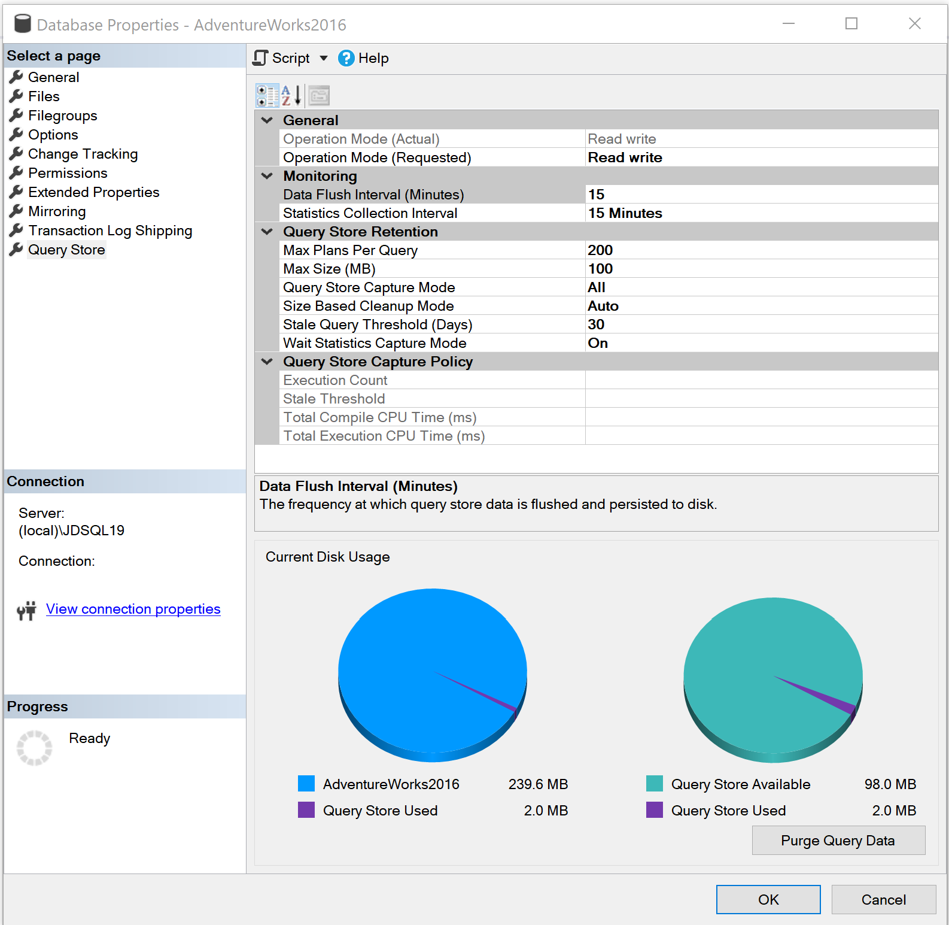
Introducing the Query Store
Query Store is set at the database level
Cannot be used for Master or TempDB system databases but can be enabled for the Model and MSDB system databases.
The user database stores the data in internal tables that can be accessed by using built-in Query Store views.
SQL Server retains this data until the space allocated to Query Store is full or manually purged.
Notes:
Please consider editing or deleting “Give me the top queries that have changed in performance compared to the number of executions. “

Slide 6
Why use Query Store?
Before Query Store
Requires manual proactive monitoring to identify execution plan problems.
Only the latest plan was stored in the procedure cache
Restart caused data to be lost
No history or aggregated gathering of data available.
Frequent recompiles of procedures or use of DBCC FREEPROCACHE
It works across server restarts, upgrades, and query recompilation
With Query Store
It stores the history of the execution plans for each query
It establishes a performance baseline for each plan over time
It identifies queries that may have regressed
It is possible to force plans quickly and easily
Notes:
Parameter-sensitive? GLOBAL query
GLOBAL: Do not capitalize generic terms. Please note that we do not capitalize terms unless they are from the UI or are feature or product names. Please consider lowercasing such terms throughout this document.
GLOBAL: Please avoid using first person (“we”, “I”) Always use “you” or “Microsoft” if that is applicable.
…have a lot of …?

Slide 7
Query Store contains three stores
Plan Store
Runtime Stats Store
Wait Stat Store
Stores Query Text and Query Plan information
Introduced in SQL Server 2017 and Azure SQL Database
Organizes wait stats into different wait categories to simplify troubleshooting similar wait types.
Captures Compile Time, Duration, CPU usage, Writes, and both Logical and Physical Reads
To minimize space usage, the runtime stats are aggregated over a fixed time window.
You can limit the number of unique plans by using the max_plans_per_query configuration.
Persists execution plan information
Persists execution statistics information
Persists wait statistics information
Notes:
Parameter-sensitive? GLOBAL query
GLOBAL: Do not capitalize generic terms. Please note that we do not capitalize terms unless they are from the UI or are feature or product names. Please consider lowercasing such terms throughout this document.
GLOBAL: Please avoid using first person (“we”, “I”) Always use “you” or “Microsoft” if that is applicable.
…have a lot of …?

Slide 8
Lesson 2 Query Store Settings

Slide 9
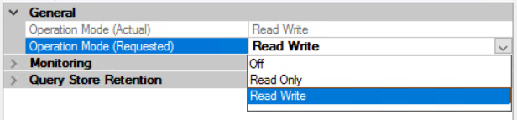
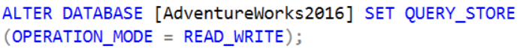
Query Store Operation Modes
Operation Mode can be set under database properties
Operation Mode can be enabled two ways using T-SQL. If only using the ON option, the Mode defaults to Read_Write

Slide 10
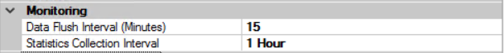
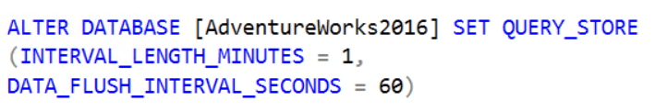
Query Store Monitoring Settings
Data Flush Interval determines the frequency at which data written to the query store is persisted to disk. (Default is 15 Minutes).

Slide 11
Query Store Monitoring Settings
Statistics Collection Interval determines the time interval at which runtime execution statistics data is aggregated into the query store. Only the values of 1, 5, 10, 14, 60, and 1440 minutes is allowed. (Default is 60).

Slide 12
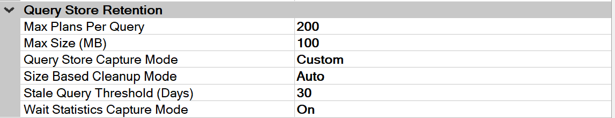
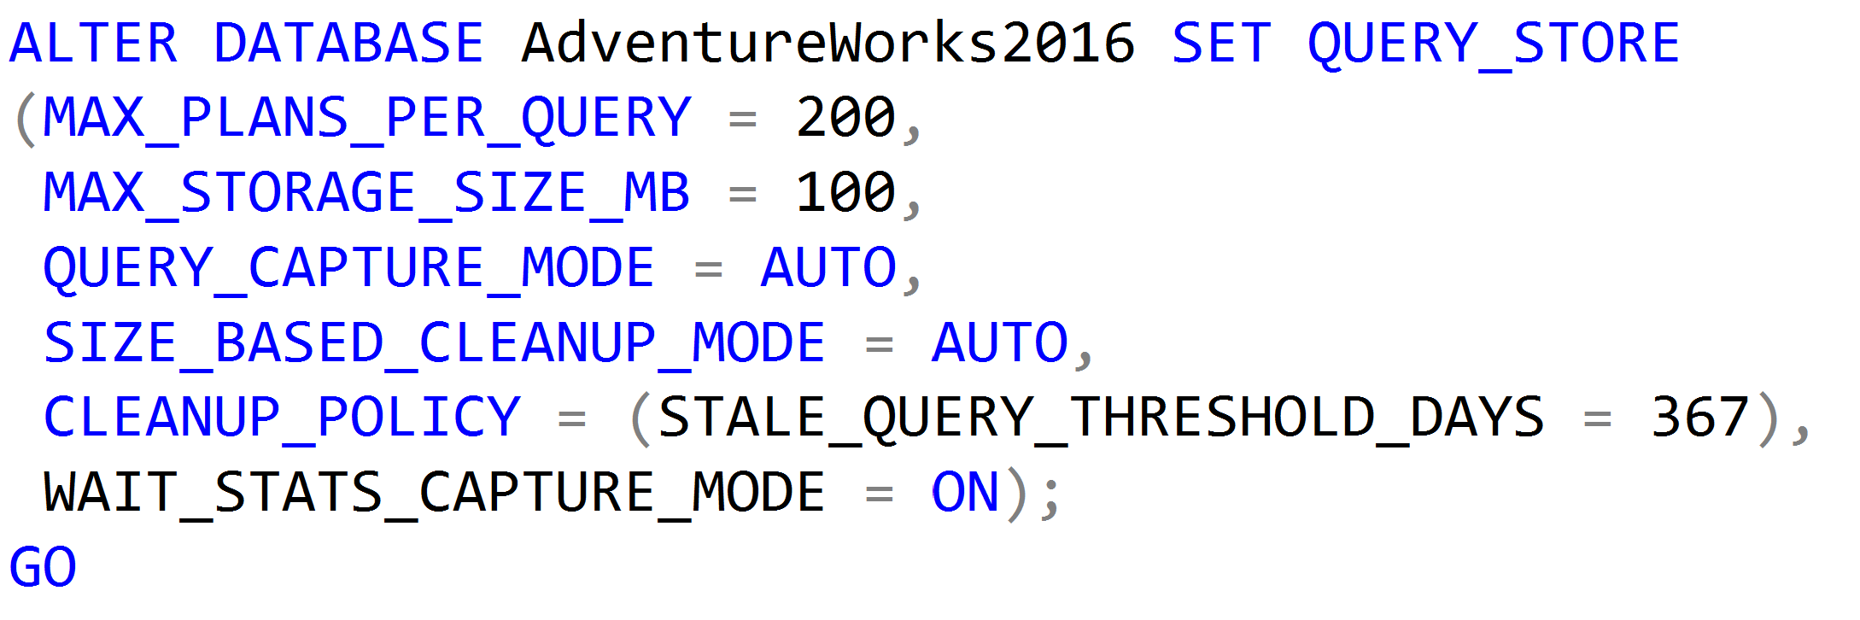
Query Store Retention Settings
Max Plans Per Query is a new retention setting introduced in SQL Server 2017 and is an integer representing the maximum number of plans maintained for each query. (Default is 200).

Slide 13
Query Store Retention Settings
Max Size (MB) configures the maximum storage size for the query store. (Default is 100MB) When the query store limit is reached, query store changes the state from read-write to read-only.

Slide 14
Query Store Retention Settings
Query Store Capture Mode determines to capture all the queries (Default is ALL), or relevant queries based on execution count and resource consumption (AUTO) or stop capturing queries (NONE). SQL Server 2019 introduces an additional (CUSTOM) setting.

Slide 15
Query Store Retention Settings
Size Based Cleanup Mode determines whether the cleanup process will be automatically activated when the total amount of data gets close to the maximum size. (Default is Auto).

Slide 16
Query Store Retention Settings
Stale Query Threshold (Days) determines the number of days to retain data in the query store. (Default is 30 days and Maximum is 367 days).

Slide 17
Query Store Retention Settings
Wait Statistics Capture Mode is a new retention setting introduced in SQL Server 2017 that controls if Query Store captures wait statistics information.
(Default = ON).

Slide 18
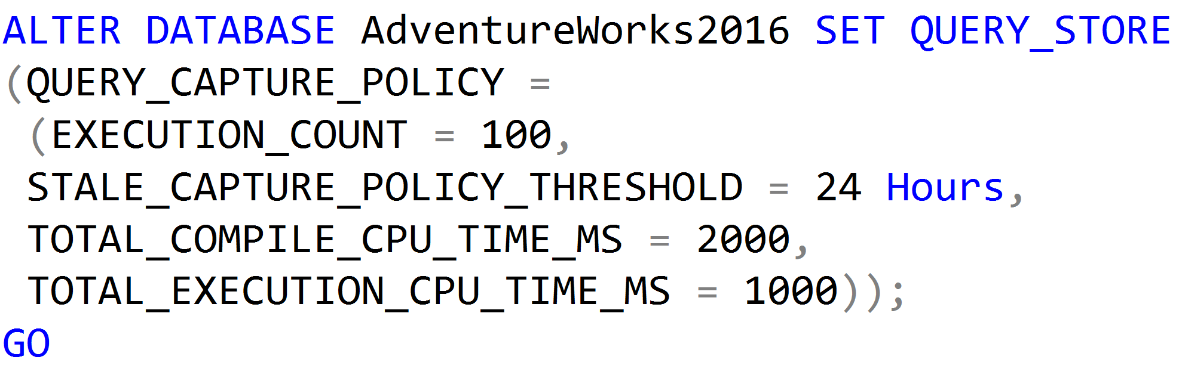
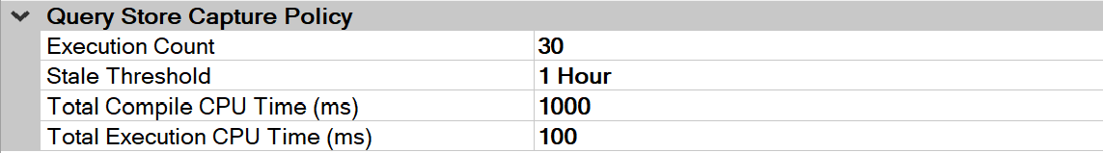
Query Store Capture Policy Settings
Introduced in SQL Server 2019 and available if the Query Store Capture Mode setting has been set to CUSTOM.
The value for the EXECUTION COUNT is the value a query must exceed within the Stale Threshold time period to be captured by the Query Store.

Slide 19
Query Store Capture Policy Settings
Introduced in SQL Server 2019 and available if the Query Store Capture Mode setting has been set to CUSTOM.
The value for the Stale Threshold can be from 1 hour up to 7 days. This setting specifies the time given to exceed the values of the three other settings for a query to be captured.

Slide 20
Query Store Capture Policy Settings
Introduced in SQL Server 2019 and available if the Query Store Capture Mode setting has been set to CUSTOM.
The value for the Total Compile CPU Time (ms) is the value in milliseconds that a query must exceed within the Stale Threshold time period to be captured by the Query Store.

Slide 21
Query Store Capture Policy Settings
Introduced in SQL Server 2019 and available if the Query Store Capture Mode setting has been set to CUSTOM.
The value for the Total Execution CPU Time (ms) is the value in milliseconds that a query must exceed within the Stale Threshold time period to be captured by the Query Store.

Slide 22
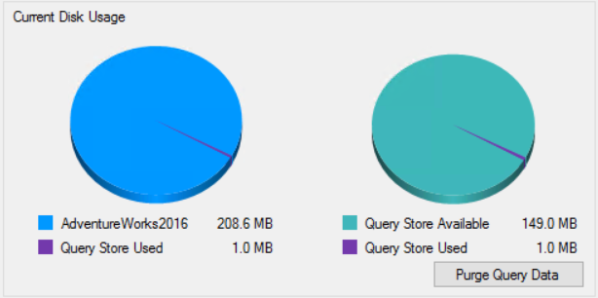
Purge Query Data
Data can be manually purged from the Query Store.

Slide 23
Demonstration

Slide 24
Lesson 3 Troubleshooting with Query Store Reports

Slide 25
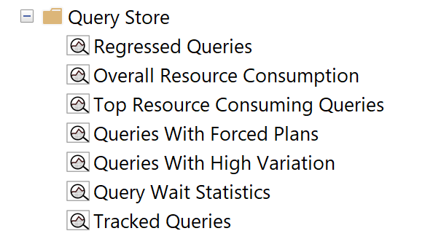
Query Store Reports
Regressed Queries: Use this dashboard to review queries that might have regressed because of execution plan changes
Notes:
Parameter-sensitive? GLOBAL query
GLOBAL: Do not capitalize generic terms. Please note that we do not capitalize terms unless they are from the UI or are feature or product names. Please consider lowercasing such terms throughout this document.
GLOBAL: Please avoid using first person (“we”, “I”) Always use “you” or “Microsoft” if that is applicable.
…have a lot of …?

Slide 26
Query Store Reports
Overall Resource Consumption: Use this dashboard to visualize overall resource consumption during the last month in four charts: duration, execution count, CPU time, and logical reads
Notes:
Parameter-sensitive? GLOBAL query
GLOBAL: Do not capitalize generic terms. Please note that we do not capitalize terms unless they are from the UI or are feature or product names. Please consider lowercasing such terms throughout this document.
GLOBAL: Please avoid using first person (“we”, “I”) Always use “you” or “Microsoft” if that is applicable.
…have a lot of …?

Slide 27
Query Store Reports
Top Resource Consuming Queries: Use this dashboard to review queries in the set of top 25 resource consumers during the last hour
Notes:
Parameter-sensitive? GLOBAL query
GLOBAL: Do not capitalize generic terms. Please note that we do not capitalize terms unless they are from the UI or are feature or product names. Please consider lowercasing such terms throughout this document.
GLOBAL: Please avoid using first person (“we”, “I”) Always use “you” or “Microsoft” if that is applicable.
…have a lot of …?

Slide 28
Query Store Reports
Queries With Forced Plans: Used to isolate queries that have been given a forced plan. Requires SQL Server 2016 SP1 or later.
Notes:
Parameter-sensitive? GLOBAL query
GLOBAL: Do not capitalize generic terms. Please note that we do not capitalize terms unless they are from the UI or are feature or product names. Please consider lowercasing such terms throughout this document.
GLOBAL: Please avoid using first person (“we”, “I”) Always use “you” or “Microsoft” if that is applicable.
…have a lot of …?

Slide 29
Query Store Reports
Queries With High Variation: Used to locate queries with high variation in query execution. Useful to locate queries with parameterization problems. Requires SQL Server 2016 SP1 or later.
Notes:
Parameter-sensitive? GLOBAL query
GLOBAL: Do not capitalize generic terms. Please note that we do not capitalize terms unless they are from the UI or are feature or product names. Please consider lowercasing such terms throughout this document.
GLOBAL: Please avoid using first person (“we”, “I”) Always use “you” or “Microsoft” if that is applicable.
…have a lot of …?

Slide 30
Query Store Reports
Query Wait Statistics shows a bar chart containing the top wait categories in the Query Store. Use the drop down at the top to select an aggregate criteria for the wait time: avg, max, min, std dev, and total (default). Requires SQL Server 2017.
Notes:
Parameter-sensitive? GLOBAL query
GLOBAL: Do not capitalize generic terms. Please note that we do not capitalize terms unless they are from the UI or are feature or product names. Please consider lowercasing such terms throughout this document.
GLOBAL: Please avoid using first person (“we”, “I”) Always use “you” or “Microsoft” if that is applicable.
…have a lot of …?

Slide 31
Query Store Reports
Tracked Queries: Use this dashboard to monitor the execution plans and regression of a specify query
Notes:
Parameter-sensitive? GLOBAL query
GLOBAL: Do not capitalize generic terms. Please note that we do not capitalize terms unless they are from the UI or are feature or product names. Please consider lowercasing such terms throughout this document.
GLOBAL: Please avoid using first person (“we”, “I”) Always use “you” or “Microsoft” if that is applicable.
…have a lot of …?

Slide 32
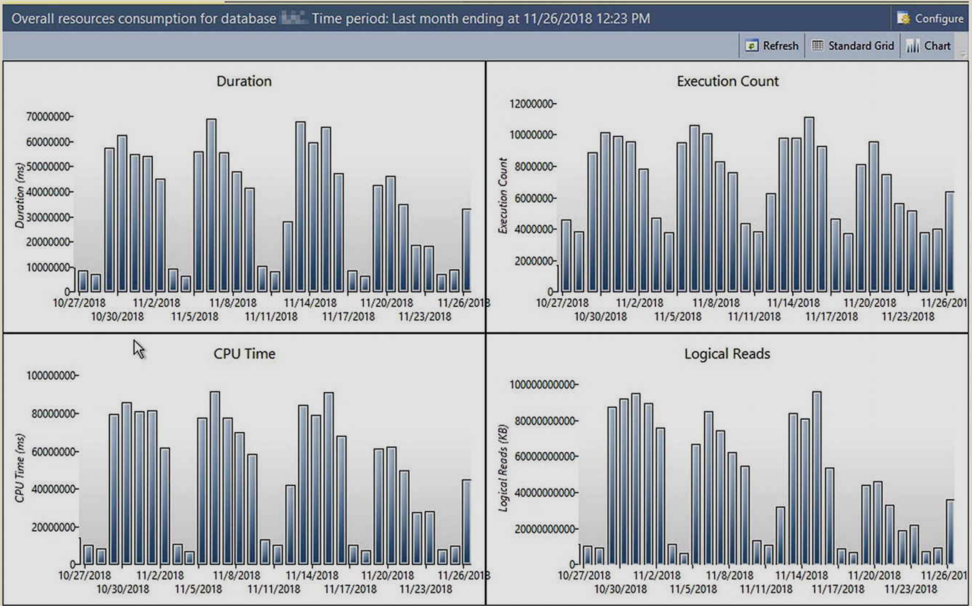
Establishing a Baseline
Notes:
Picture provide by Tracy Boggiano from her book Query Store for SQL Server 2019.
GLOBAL: Please avoid using first person (“we”, “I”) Always use “you” or “Microsoft” if that is applicable.

Slide 33
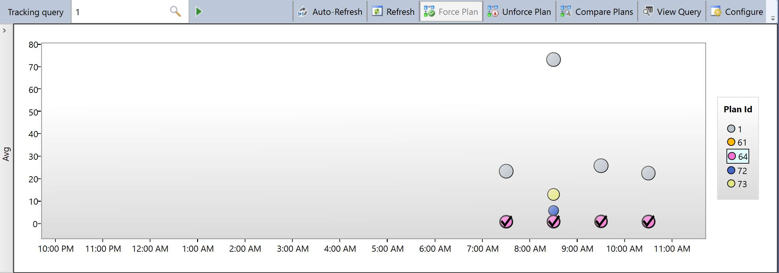
Force Plan
Notes:
GLOBAL: Please avoid using first person (“we”, “I”) Always use “you” or “Microsoft” if that is applicable.

Slide 34
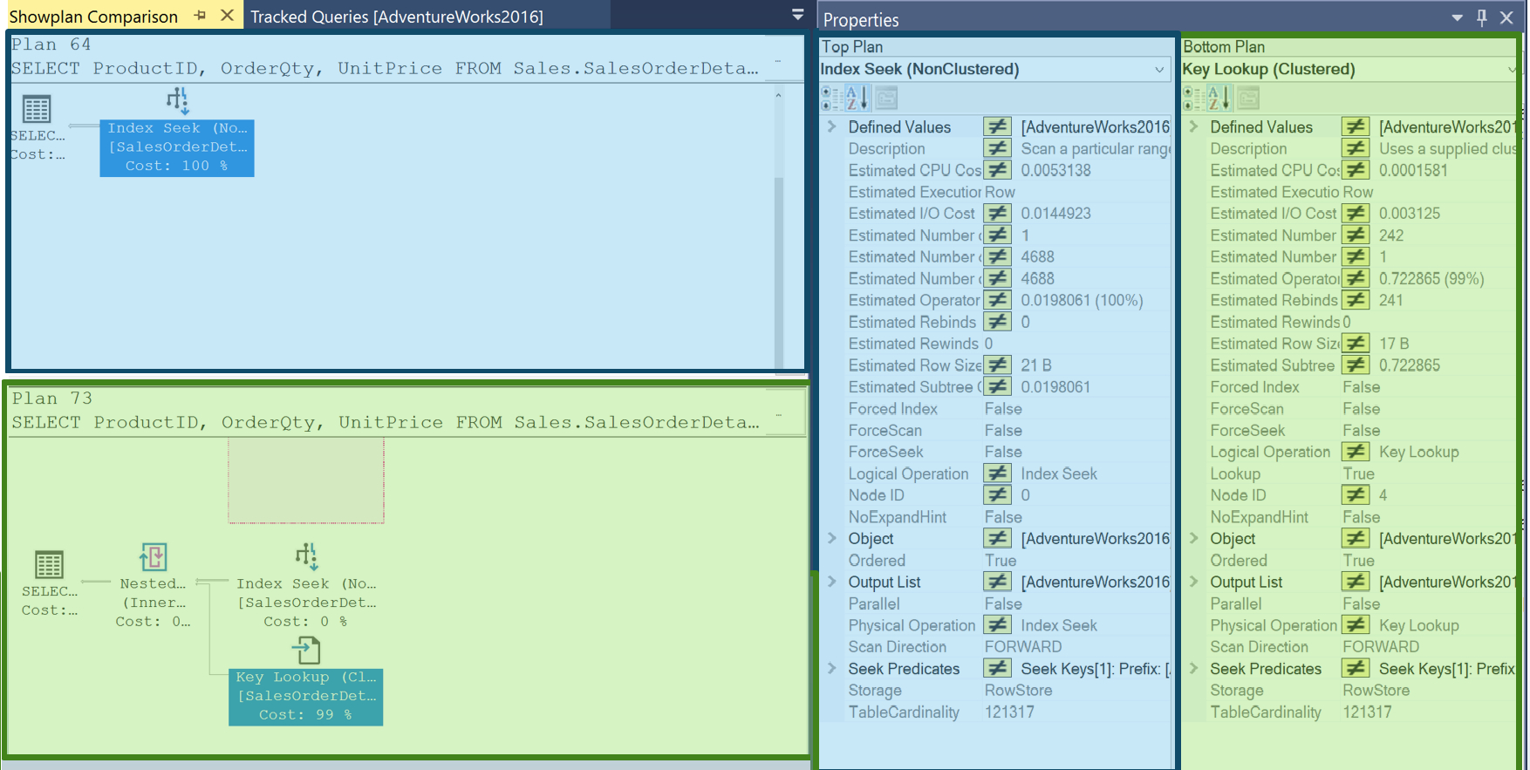
Plan Compare
Notes:
What version does “Before” refer to?
“query store compare plans was a complicated ” is unclear – please revisit.

Slide 35
Questions?

Slide 36
Lesson 4 Query Store Catalog Views

Slide 37
Query Store contains three stores
Plan Store
Runtime Stats Store
Wait Stat Store
Stores Query Text and Query Plan information
Introduced in SQL Server 2017 and Azure SQL Database
Organizes wait stats into different wait categories to simplify troubleshooting similar wait types.
Captures Compile Time, Duration, CPU usage, Writes, and both Logical and Physical Reads
To minimize space usage, the runtime stats are aggregated over a fixed time window.
You can limit the number of unique plans by using the max_plans_per_query configuration.
Persists execution plan information
Persists execution statistics information
Persists wait statistics information
Notes:
Parameter-sensitive? GLOBAL query
GLOBAL: Do not capitalize generic terms. Please note that we do not capitalize terms unless they are from the UI or are feature or product names. Please consider lowercasing such terms throughout this document.
GLOBAL: Please avoid using first person (“we”, “I”) Always use “you” or “Microsoft” if that is applicable.
…have a lot of …?

Slide 38
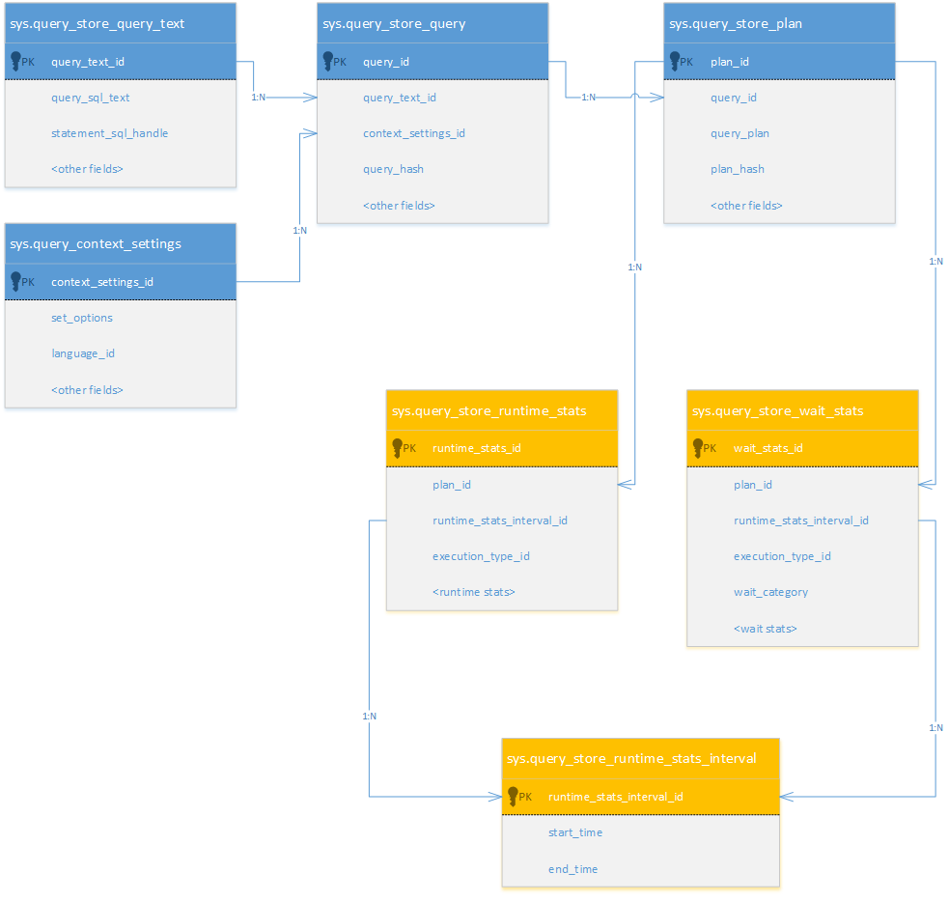
Query Store Catalog Views
Query Store Information
Compile Time Information

Slide 39
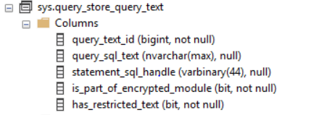
sys.query_store_query_text
Presents the unique query text that is executed against the database.
Every statement in a batch generates a separate query text entry.

Slide 40
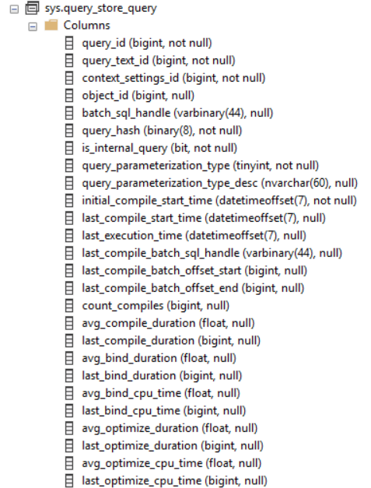
sys.query_store_query
Presents the query entries that are tracked and forced separately in the Query Store.
A single query text can produce multiple query entries that are executed under different context settings.

Slide 41
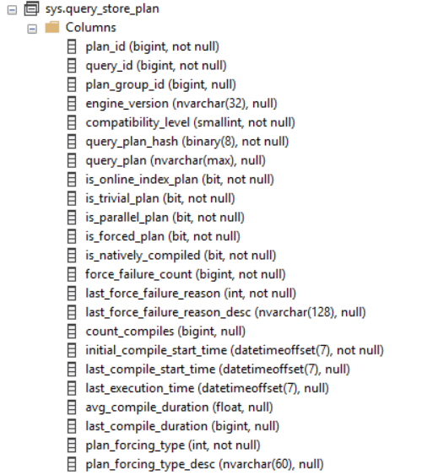
sys.query_store_plan
Presents the estimated plan for the query with the compile time statistics.

Slide 42
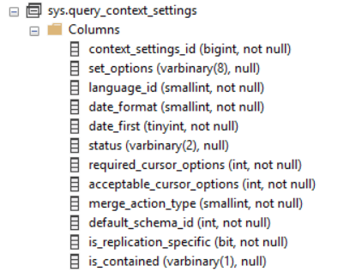
sys.query_context_settings
Presents the unique combinations of settings that affect a plan under which queries are executed.

Slide 43
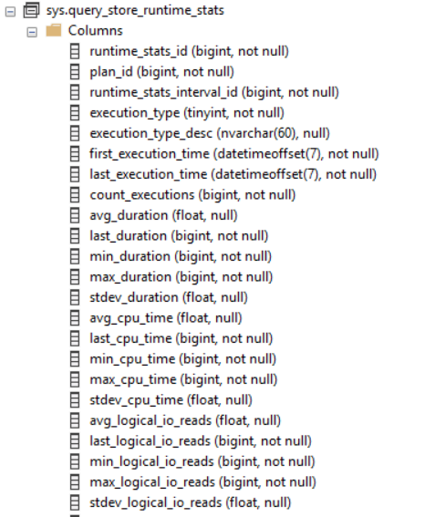
sys.query_store_runtime_stats
Aggregated runtime statistics for executed plans.
Metrics are expressed in the form of Four statistic functions. (Average, Minimum, Maximum, and Standard Deviation).

Slide 44
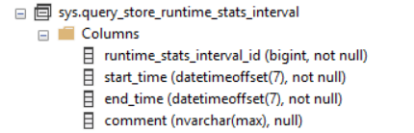
sys.query_store_runtime_stats_interval
Query Store divides time into automatically generated time windows (intervals) and stores aggregated statistics on that interval for every executed plan.

Slide 45
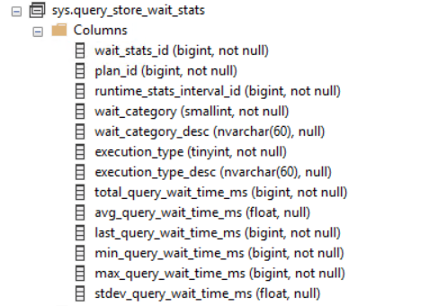
sys.query_store_plan_wait_stats
Presents wait category information for past runtime statistics interval.
Wait types are categorized and then wait time is aggregated across those wait categories.

Slide 46
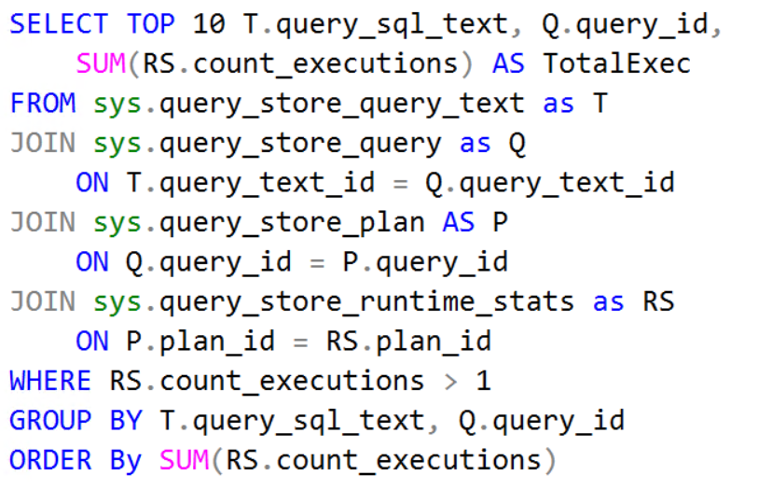
Using Query Store Catalog Views
Finding the TOP 10 most frequently executed SQL Server Queries in the Query Store.

